Slide 1

Automation and Machine Learning: How a Robot Can Conduct Its Own Experiments Using Gaussian Processes
Adi Timin and Miller Gruen
Mentored by Dr Lowe

Slide 2
Big picture
Machine Learning allows a device to make “decisions” on its own.
This can relieve scientists of difficult or time-consuming tasks
Our device is able to automate the mixing of different materials, but there are many other uses for machine learning.

Slide 3

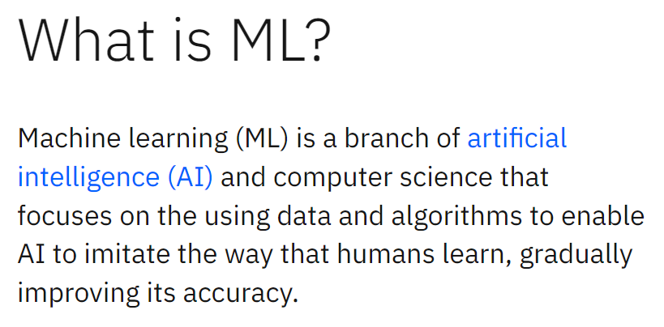
(https://www.ibm.com/topics/machine-learning)

Slide 4
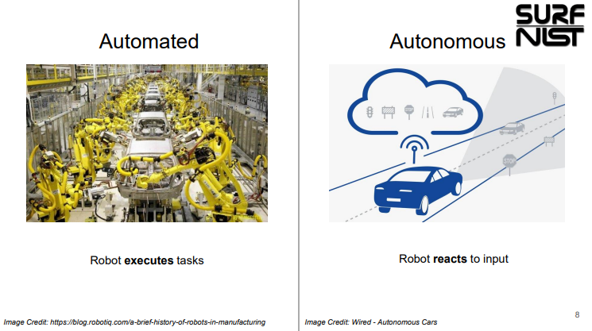

Slide 5
Experimental problem first

Slide 6
“Machine learning (ML) is a branch of artificial intelligence (AI) and computer science that focuses on the using data and algorithms to enable AI to imitate the way that humans learn, gradually improving its accuracy.” (https://www.ibm.com/topics/machine-learning)
Decides next data point to take to decrease uncertainty and use least number of measurements
Goal: predictive power
Measurements are training data
Supervised learning, classification vs regression , gaussian processes are a type of regression

Slide 7

Bayesian Probability
P(E|H) * P(H)
P(H|E) =
P(E|H) * P(H) + P(E|-H) * P(-H)

Slide 8
Bayesian Probability
Bill is shy and often likes to keep to himself while working.
Is Bill more likely to be a Farmer or a Librarian?

Slide 9

Bayesian Probability

Slide 10
Gaussian processes

Slide 11
What are we trying to do
Surrogate function
Fitting

Slide 12
Where is the gaussian
Rbf kernel
Data has gaussian noise

Slide 13
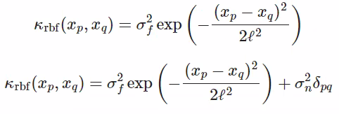
RBF Kernel

Slide 14
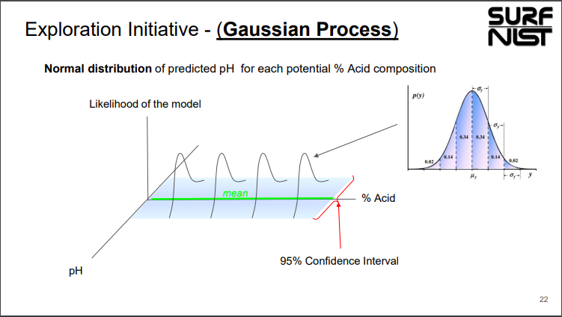

Slide 15
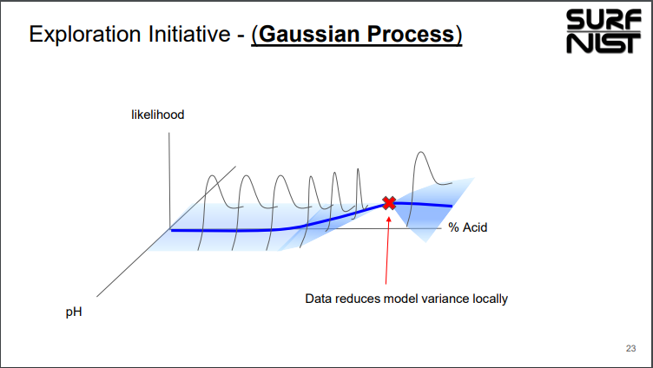

Slide 16
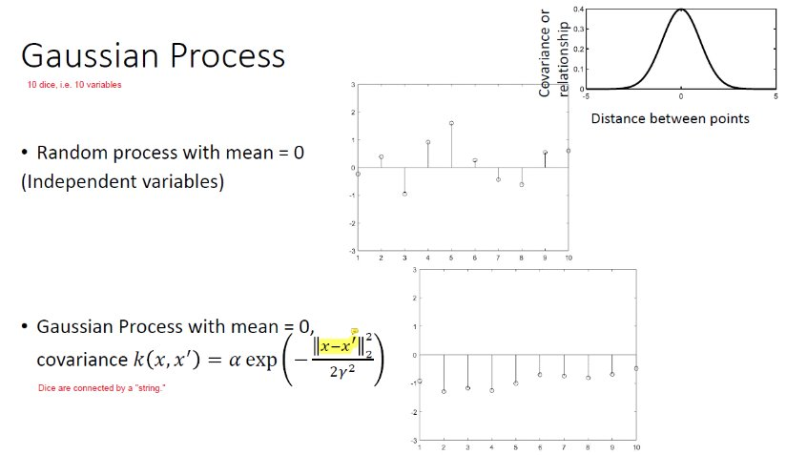

Slide 17
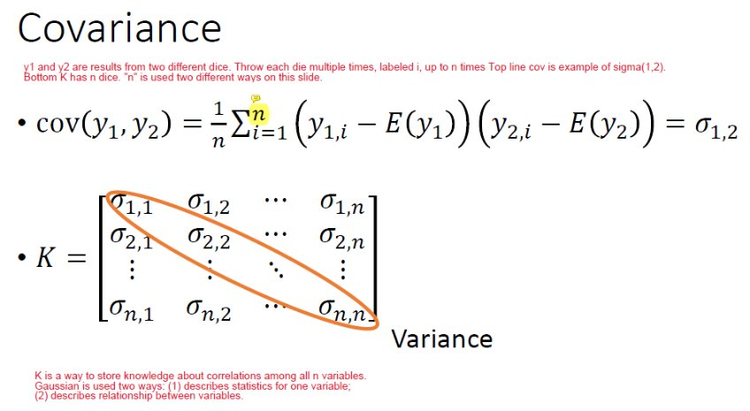

Slide 18
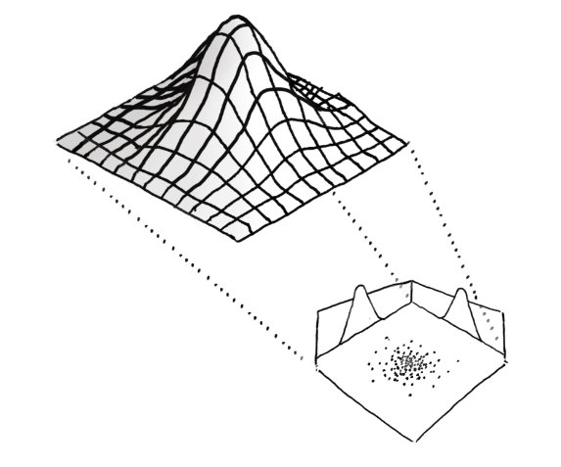

Slide 19
LEGOLAS: a history
The Apparatus used came from UMD
Built by students and faculty, largely from legos and 3d printing
The Machine Learning aspect was developed by Gilad Kusne, who is currently employed at NIST.

Slide 20
LEGOLAS: a history
Loyola related work began last summer when Dr Lowe began preliminary work
Two CS seniors for their capstone began work on a different machine learning problem of identifying wells in hopes of implementing a camera to assist in aiming the device
Two Hauber students worked on Gaussian Processes as applied to machine learning to get the robot to figure out how to take data

Slide 21
LEGOLAS
Has 2 raspberry pis and an Arduino
Can move in x, y, and z directions using Lego motors
Pipette and plunger that move in z direction
pH sensor that moves in the Z direction
Connects using a local router to a computer running Python scripts

Slide 22
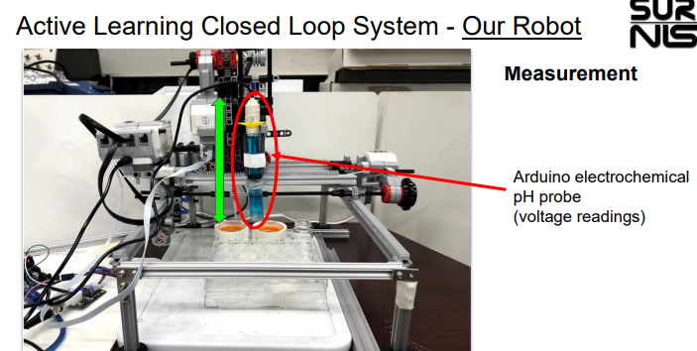
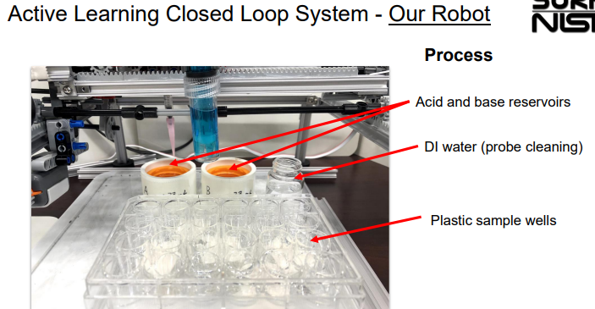
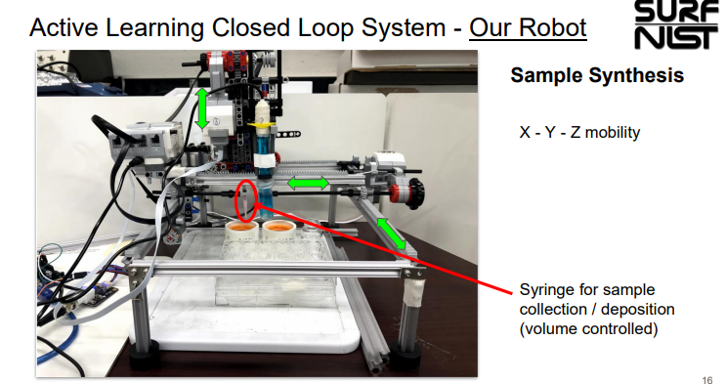
LEGOLAS
Things it can do

Slide 24
Our experiment

Slide 25
pH

Slide 26
Materials and methods
Python
Local network
GPy library

Slide 27
Materials and Methods
Stock concentrations:
0.1 M acetic acid (acid)
0.1 M sodium acetate (conjugate base)

Slide 28
prior

Slide 29
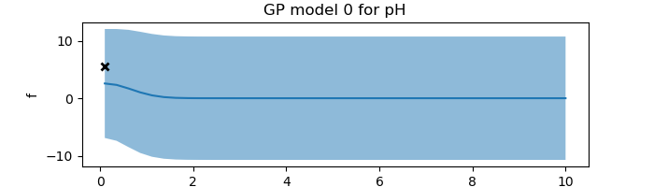
Mean of all potential functions
95% confidence interval
pH
Ratio: [acid]/[conjugate base]

Slide 30
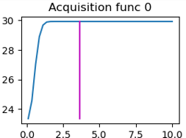
Mean of all potential functions
95% confidence interval
pH
Ratio: [acid]/[conjugate base]
The acquisition function is the variance of the graph above
The code looks for the maximum variance

Slide 31
Active learning
Baye’s Theorem applies to the active learning, as well as the ability to predict unmeasured data points

Slide 32
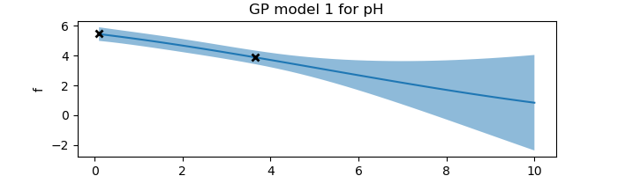
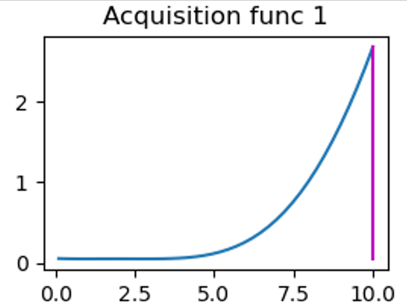
Mean of all potential functions
95% confidence interval
pH

Slide 33
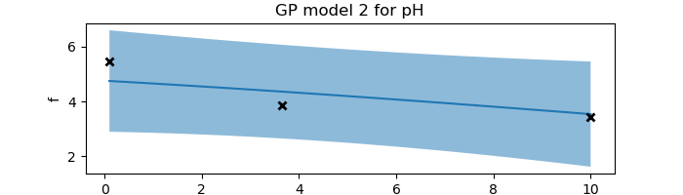
Mean of all potential functions
Note scale change
95% confidence interval

Slide 34
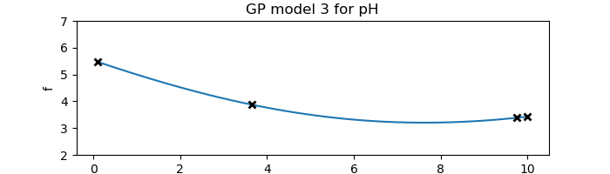
Mean of all potential functions
95% confidence interval

Slide 35
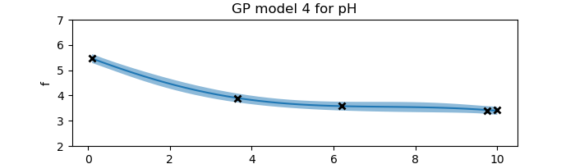
Mean of all potential functions
95% confidence interval

Slide 36
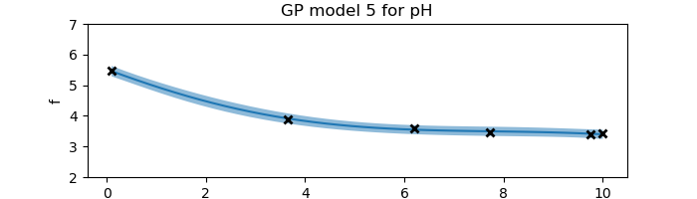
Mean of all potential functions
95% confidence interval

Slide 37
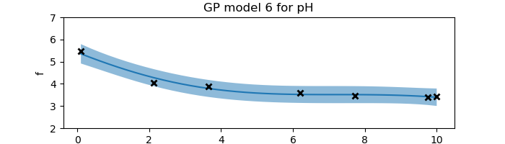
Mean of all potential functions
95% confidence interval

Slide 38
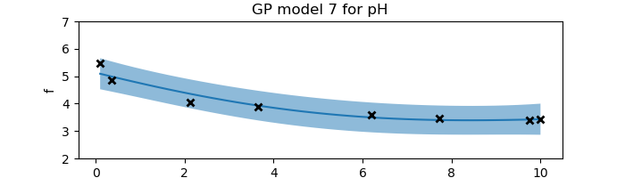
Mean of all potential functions
95% confidence interval

Slide 39
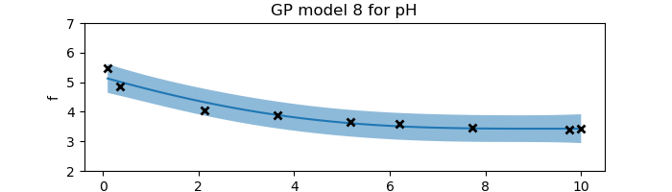
Mean of all potential functions
95% confidence interval

Slide 40

Mean of all potential functions
95% confidence interval

Slide 41
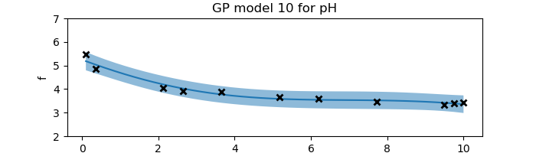
Mean of all potential functions
95% confidence interval

Slide 42
Surrogate function gives predictive power, allowing us to estimate the value of the pH at any unmeasured point

Slide 43

Henderson Hasselbach equation
It is known that the pH of an acid and conjugate base can be calculated using
where pKa = 4.74 for acetic acid.

Slide 44
Graph
The experimental data is lower than the theoretical because the carbon dioxide in the atmosphere reacts with _, producing carbonic acid in the solution, resulting in a lower pH.
[cite paper]

Slide 45
Experimental troubles

Slide 46
conclusion
Implications
What we learned

Slide 47
How we could improve in the future
Flaws in our work

Slide 48
[Future applications/purpose]
How it can be expanded in the future

